Slide 1
Time Series Database
Team 9
Balamanikandan Gopalakrishnan
Rachan Hegde

Slide 2
Agenda
Time Series Data
Storage Options
Time Series Databases
Open TSDB
MAPR
KDB
InfluxDB
OneTick
Visualizing Time Series Data
Grafana
Spark Time Series

Slide 3
Time Series Data
Time Series Data is a set of observations collected at a usually discrete and equally spaced time intervals
General Properties
Trend
Seasonality
Order Matters (Values depend upon the recent observations)
Special storage types are needed because of the volume of data and the frequency of observations

Slide 4
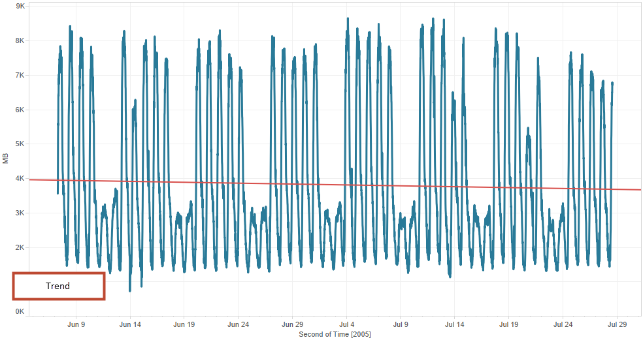
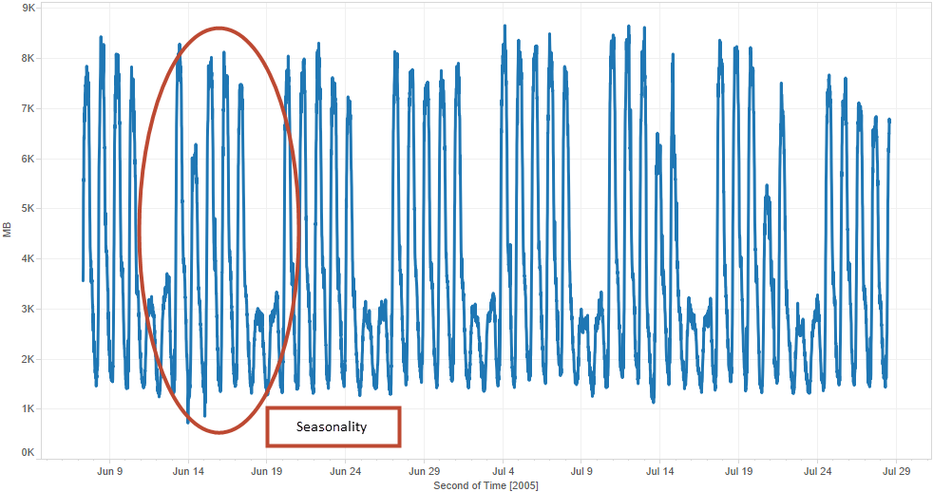
Internet Usage Data - Trend and Seasonality

Slide 5
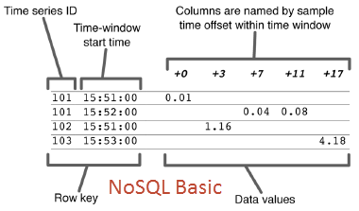
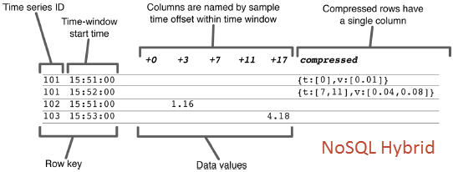
Time Series Data Storage Options
Flat Files
RDBMS
NoSQL non relational
Preferred as it scales well
Doesn’t scale well
Data will outgrow them and access is inefficient
Basic Design: Unique row keys with time series id and column is a time offset
Hybrid Design: Blob Style

Slide 6
Time Series Database – Open TSDB

Slide 7
Time Series Database – Open TSDB
Time Series Daemon (TSD)
Interaction with Open TSDB is achieved by running one or more TSD’s
Independent, can run as many TSD’s to handle load
TSD’s uses open source database HBase to store and retrieve time series data
HBase schema is highly optimized for faster aggregations of similar time series data to minimize storage space

Slide 8
Time Series Database – Open TSDB
Time Series Data Point in Open TSDB
Metric Name
Time Stamp
Value
Tags
These are used to annotate data points
The observation at a specific point in time
Time Stamp of the observation
Entity that is being tracked

Slide 9
Time Series Database – MAPR

Slide 10
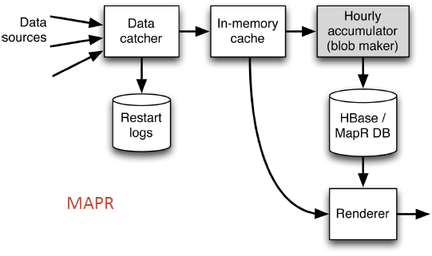
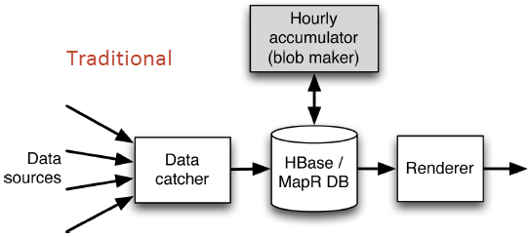
Time Series Database – MAPR
MAPR is a open source modification to extend the capabilities of Open TSDB
Direct Blob loading
Avoids performance bottlenecks

Slide 11
Time Series Database – KDB

Slide 12
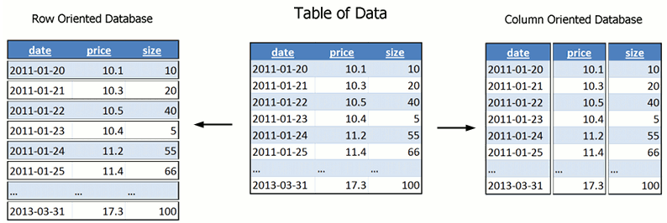
Time Series Database – KDB
KDB
In memory column-oriented database based on the concept of ordered lists
KDB uses a terse programming language Q
Data Store
RDB (Real Time Database) to store current day’s data
HDB (Historical Database)
Typically used in the following scenarios
Don’t want your data outside your firm
Don’t have in-house cloud infrastructure

Slide 13
Time Series Database – InfluxDB

Slide 14
Time Series Database – InfluxDB
InfluxDB open-source distributed time series database
InfuxDB uses BoltDB as its storage engine
Pure Go persistence solution that saves data to memory mapped file
Key Features
SQL – like query language
Database-managed retention policies for data
Built in management interface
Horizontally Scalable

Slide 15
Time Series Database – OneTick

Slide 16
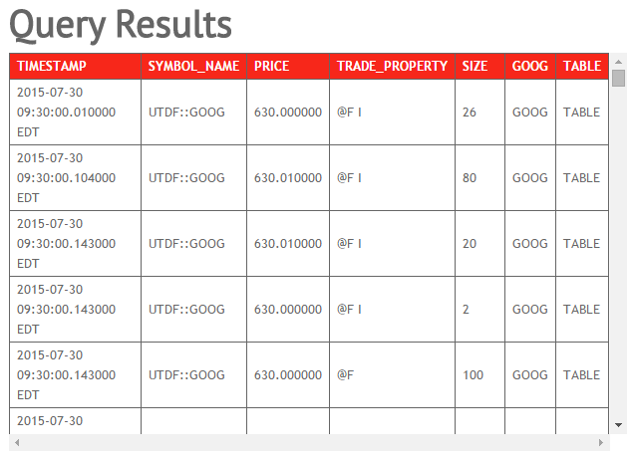
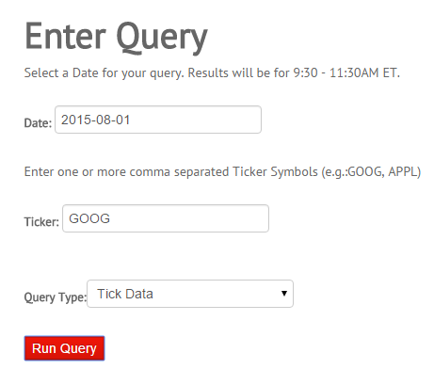
Time Series Database – OneTick
OneTickCLOUD
Hosted service providing managed data and analytics
Reference data, and adjustment factors along with on-demand analytics tools for creating custom datasets.

Slide 17
Visualizing Time Series Data – Grafana

Slide 18
Visualizing Time Series Data – Grafana
Grafana is a open source application for visualizing large-scale measurement data.
Currently supports
Open TSDB
Influx DB
Features
Rich Graphics
Dashboards
Templated Queries and Dashboards
Annotations
Multiple Data Sources

Slide 19
Spark Time Series

Slide 20
Spark Time Series
Helsinki : Spark.TimeSeries is an api for Time Series Analysis in Spark
Depends upon RunRDD that splits the data into interesting partitions using a RunDetector
Partitions are represented by Runs contained RunRDD
Cloudera: The central abstraction of the library is TimeSeriesRDD a lazy distributed collection of univariate series
Within each univariate series, observations are not distributed
Time Series Manipulation
Aligning
Slicing by date-time
Missing value imputation
Risk
Monte Carlo Simulation
Bootstrap Historical Simulation

Slide 21
Questions?

